Slide 1



Intrusion Detection Systems: Intelligent Techniques and Design Methodologies
by Sri Iyer

Slide 2
AI-Based Techniques in IDS
Flexibility
Adaptability
Pattern Recognition
AI-based techniques offer flexibility in parameter value choices, unlike the rigid thresholds in conventional methods.
These techniques adapt over time, improving their detection capabilities beyond the fixed rules of traditional systems.
Advanced pattern recognition enables the detection of new and evolving intrusion patterns, enhancing security measures.
Speed
Learning Capabilities
AI methods often compute faster than conventional techniques, providing timely responses to potential threats.
The inherent learning capabilities of AI allow for continuous improvement and evolution of intrusion detection strategies.

Slide 3

Unlocking the Power of ML Techniques
1
Learning by Example
2
Automatic Signature Extraction
Intelligent techniques can generalize from examples, enabling the detection of new intrusion types.
Attack signatures are automatically extracted from labeled data, reducing subjective human interpretation.
3
Adaptation to Threats
4
Enhancing Intrusion Detection Systems
Learning approaches can adapt to unknown or modified threats, maintaining robust defense mechanisms.
ML techniques empower the enhancement of intrusion detection systems, improving accuracy and efficiency.

Slide 4
Challenges in Technique Selection
1
No Single Solution
2
Local Minima
3
Hypothesis Space
No single classification technique can detect all attack classes with low false alarm and miss rates.
Some techniques may get trapped in local minima during training, making them computationally expensive for real-life applications.
Existing techniques may not correctly model the hypothesis space of problems, leading to inaccuracies.
4
Unstable Results
5
Performance Variations
Techniques like neural networks can produce unstable results due to randomness in the training process.
Different techniques may show strong local performance variations, each excelling in different regions of the feature space.

Slide 5
Evaluation Dataset Challenges
1
Lack of Big Datasets
2
Quality Training Data
3
Class Imbalance
There is a scarcity of large datasets that can serve as benchmarks for IDS design and technique testing.
Class imbalance in datasets can lead to classifier bias, favoring majority classes and skewing results.
Insufficient quality training data hampers the development of effective IDS models.

Slide 6
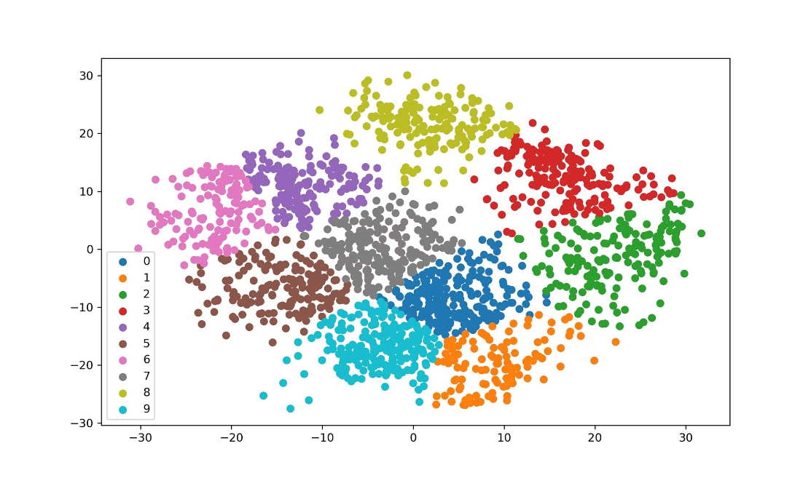
IDS Design based on K-Means Algorithm
The K Means Algorithm is a popular clustering algorithm used in data analysis and machine learning. It aims to partition a given dataset into K distinct clusters, where each data point belongs to the cluster with the nearest mean value.

Slide 7
IDS Design based on K-Means Algorithm
Algorithm Overview
Anomaly and Misuse Detection
Challenges and Adaptations
K-Means is a vector quantization algorithm that classifies data points into separate groups to minimize variance within clusters.
K-Means can be employed for both anomaly and misuse detection, offering fast analysis of new data points relative to cluster centroids.
While k-Means can produce high false positives and requires careful cluster count selection, adaptations like Y-means address these issues.

Slide 8
IDS Design based on K-Nearest Neighbour Algorithm
Neighbor-based Classification
Decision Boundary
Choosing K
KNN determines the class of a new data point by considering the classes of its k nearest neighbors. The decision boundary is flexible and adapts to the distribution of the training data.
One of the key considerations in KNN is selecting the appropriate value of k, which determines the number of neighbors to consider. This choice impacts both accuracy and computational complexity.
The K-Nearest Neighbours (KNN) algorithm is a popular neighbor-based classification technique used in Intrusion Detection Systems (IDS) to classify network traffic based on its similarity to known patterns.

Slide 9
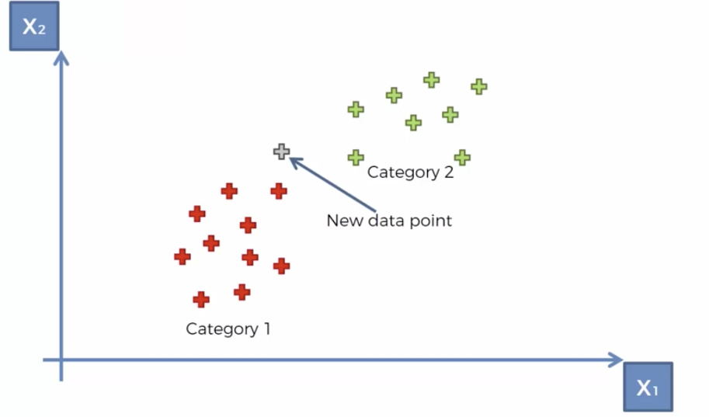
IDS Design based on K-Nearest Neighbour Algorithm
Core Concept
Supervised Learning
Parameter Selection
The k-nearest neighbor algorithm classifies unknown data points by analyzing the known data points closest to them in feature space.
kNN is a supervised learning method that requires a pre-classified dataset for effective classification of new data.
Choosing the right values for k and d is crucial for accurate classification and minimizing false results.

Slide 10
IDS Design based on Genetic Algorithm
Evolutionary Approach
Key Components
Challenges and Efficiency
Genetic algorithms mimic natural selection, evolving solutions over generations to optimize for a given fitness function.
GA involves a search space, population, fitness function, recombination, and mutation to find optimal solutions.
While GAs can be highly effective, they depend on a comprehensive training dataset and can be resource-intensive during training.

Slide 11

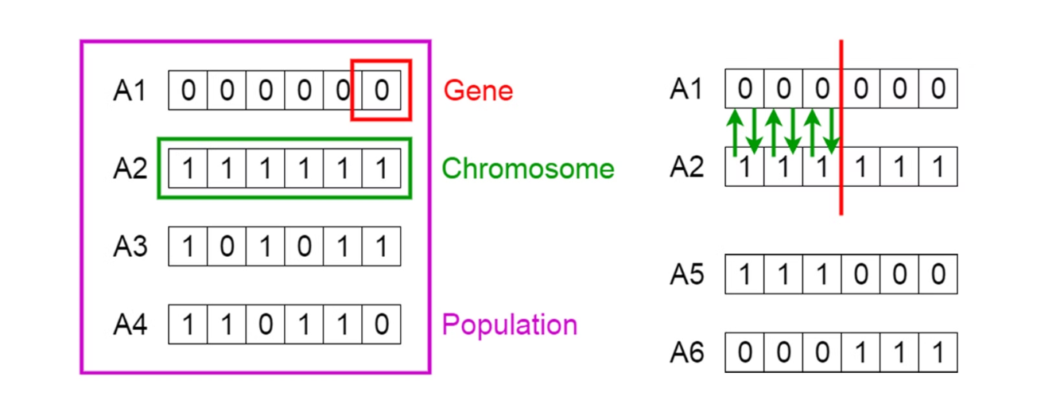
IDS Design based on Genetic Algorithm
Intrusion Detection Systems (IDS) can benefit from the application of Genetic Algorithms (GA). By mimicking the process of natural selection, GA can optimize IDS parameters and improve detection accuracy. Discover how Genetic Algorithms enhance IDS design and contribute to effective threat detection.

Slide 12
ANN Structures and their choice for intrusion detection
Shallow ANN Topologies
ANN Architecture
Optimization with GA
Shallow ANN topologies and their ensembles are explored for IDS, balancing detection accuracy and resource consumption.
The choice of ANN architecture is critical, as it influences the system's performance and its ability to generalize for unknown attacks.
ANNs can be initially trained and later optimized with genetic algorithms to minimize training time and maximize performance.

Slide 13
Experimental Setup and Datasets
Benchmark Datasets
Preprocessing for ANN
Heterogeneous Systems
Research teams utilize benchmark datasets like DARPA and KDD Cups to evaluate IDS designs and AI technique applications.
Preprocessing the initial dataset for ANN training and testing allows for dimension reduction and faster training times.
Different agents with various functionalities are employed in a heterogeneous system to enhance IDS design and performance.

Slide 14
IDS Design with multiple Intelligent Heterogenous Agents
Biological and Social Inspiration
Agent Responsibilities
Autonomous Cooperation
Agents are segmented by responsibilities, including data preprocessing, supervision, classification, and result validation.
The model simulates human brain operation and organizational hierarchy, using a multi-agent architecture for classification.
Agents autonomously perform their duties while cooperating with others, enhancing the IDS's adaptability and fault tolerance.

Slide 15
Classification Accuracy and Adaptability
Accuracy Experiments
Adaptation to Novel Attacks
Performance Gains
Experiments gauge classification accuracy, demonstrating that increasing the number of agents improves detection rates.
Significant performance gains are observed when replacing a single ANN with a double one, though further increases show diminishing returns.
Introducing novel attacks to the system triggers retraining, showcasing the multi-agent IDS's ability to adapt and learn.

Slide 16
IDS Performance and Resource Consumption
Optimal Performance
Training Set Size
Resource Management
Finding the balance between IDS performance and resource consumption is key to efficient and effective security systems.
The size of the training set and the training time are crucial parameters that affect the resource consumption in ANN applications.
Managing resources such as the number of generations in GA and agents in multi-agent systems is essential for sustainable IDS operation.

Slide 17
Advancements in IDS Research
From Rule-Based to AI
AI Techniques
Future Directions
IDS research has evolved from rule-based systems to sophisticated AI models, emphasizing the need for learning and self-modification.
AI techniques, particularly ANN, have become a promising direction in intrusion detection due to their adaptability and evolution capabilities.
The ongoing research in IDS aims to create complex hierarchical systems that integrate various AI models for robust network security.

Slide 18
Statistical Approaches in IDS
Operational Models
Expert Systems
ML-Based Models
Statistical approaches in IDS employ operational models like Markov models to predict and detect intrusions based on data patterns.
Cognition-based or knowledge-based systems utilize expert systems and fuzzy logic for intelligent intrusion detection.
Machine learning models such as Bayesian networks and neural networks are applied for their predictive capabilities in IDS.

Slide 19
Artificial Immunology in IDS
Artificial immunology introduces a novel approach to IDS by mimicking the human immune system's ability to identify and respond to foreign entities. This technique leverages the concept of self and non-self to distinguish between normal network behavior and potential threats, offering a dynamic and responsive defense mechanism. The application of artificial immunology in IDS design is a testament to the interdisciplinary nature of cybersecurity research, drawing inspiration from biology to enhance digital security.

Slide 20
Hot Topics in IDS Research
The field of IDS is rife with hot topics that captivate researchers and practitioners alike. The application of intelligent methods in IDS design remains a focal point, with numerous publications reporting on the challenges and opportunities presented by AI-based techniques and datasets. As the landscape of cyber threats evolves, so too does the need for innovative solutions that can adapt to new attack vectors and sophisticated adversaries. This ongoing dialogue within the research community is crucial for the development of next-generation IDS technologies.

Slide 21




Technique Selection Challenges
Global vs. Local Performance
Training Pitfalls
Stability Concerns
Finding the global minimum in training can be computationally prohibitive, leading to suboptimal performance.
Techniques that incorporate randomness, such as neural networks, may yield unstable and inconsistent results.
Techniques may vary in their effectiveness, with some excelling globally and others showing strength in specific localities.

Slide 22




Building Quality Datasets for IDS
Benchmark Datasets
Creating large, quality benchmark datasets is essential for testing and refining IDS techniques.
Training Data Sufficiency
Adequate training data is necessary to build robust models capable of detecting a wide range of intrusions.
Addressing Class Imbalance
Strategies must be developed to address class imbalance, ensuring fair representation of attack types in datasets.

Slide 23
Optimizing K-Means for IDS
1
Initial Clustering
K-Means begins by attempting to find stable groups within the data, a process that is computationally intensive.
2
Heuristic Solutions
Heuristic algorithms, while not guaranteeing a global optimum, often provide practical solutions to the clustering problem.
3
Enhancing Efficiency
Techniques like k-means++ and dimensionality reduction can significantly improve the efficiency of the algorithm.

